Slide 1
City of Ely
FY 22-23 Budget Introduction
Adam Thompson
Cindy Kendall

Slide 2
Historic Property Tax
Notes:
FY21-22 Goal 10.81-10.99

Slide 3
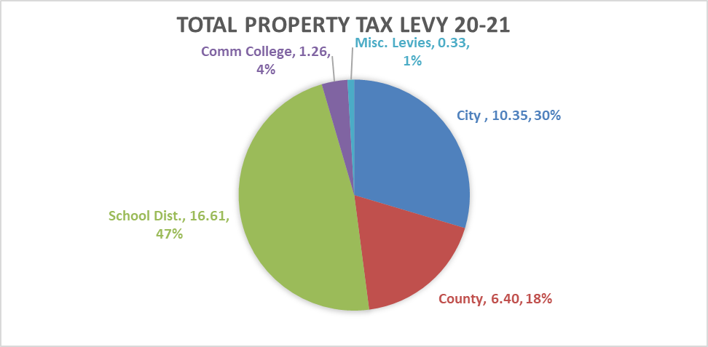
Combined Property Tax Levy 20-21
Notes:
Total Levy 34.94 / $1000

Slide 4
Combined Property Tax Levy 21-22

Slide 5
Comparable Communities
Low High
Fairfax Solon Ely Prairie City Blue Grass Tiffin Huxley Hull Center Point

Slide 6
Overview of Revenues
For the current budget FY 21-22 property tax and tax Increment financing account for $1,435,562 (31%) of revenues that supported the General fund and debt service repayments.
The second largest revenue was charges for services at $1,120,075 (24%). within the water, sewer and storm sewer utilities. Small amounts of service fees can also be attributed to park and rec, the library and the rents at city hall.
Revenues from other governments total $571,678 (12%) double that of last fiscal year due to federal incentives and Covid relief. Other city taxes, such as Local Option Sales Tax and Utility Franchise tax contributed $284,908 (6%) another increase over FY 21. Licenses, permits, use of money and property and miscellaneous revenues combined totaled $65,450 across all funds.

Slide 7
Overview of Revenues

Slide 8
Valuation History
Well position to hold tax rate consistent with FY22 of $10.96/$1,000 of taxable valuation

Slide 9
General Fund
Due to the $8.10/1,000 of taxable property limitations in the general fund, the capacity for revenue growth is limited even considering the amount of growth in Ely’s valuation.
Roll back formula not controlled by the City
Council approve $25,000 transfer to equipment reserve
With little commercial or industrial property in Ely, the back fill impact falls into the four-year phase out schedule shown below:

Slide 10
Road Use Tax
2020 census is the controlling population of 2,328
Use for public expenditures related to streets, storm sewers, streetlights and other traffic control signals.
FISCAL YEAR (FY) | DOT EXTIMATE PER CAPITA | DOLLAR VALUE OF ESTIMATE | AMOUNT PROJECTED ($1 less than DOT)
FY 2022 | $125.50 | $292,164. | $289,836.
FY 2023 | $126.50 | $294,492. | $292,164.
FY 2024 | $127.50 | $296,820. | $294,492.
FY 2025 | $128.00 | $297,984. | $295,656.
FY 2026 | $129.00 | $300,312. | $297,984.

Slide 11
Local Option Sales Tax
Sunset of 6-30-2034
The specific purposes are: Community improvements to include streets, storm sewer/runoff management, wastewater treatment, sanitary sewer and water infrastructure improvements, park/recreation improvements, reduction of short-term debt and other community improvements projects.
FISCAL YEAR (FY) | AMOUNT RECEIVED/OR PROJECTED
FY 2018 | $196,020.
FY 2019 | $216,846.
FY 2020 | $244,797.
FY 2021 | $270,121. | Increase in on-line spending
FY 2022 | $333,496. | Iowa Revenue Estimating Committee
FY 2023 | $380,186. | Up 14 percent¹
FY 2024 | $433,412. | Up 14 percent¹
¹Source: Iowa Revenue Estimating Committee suggested 17% increase possible

Slide 12
TIF
Tax increment finance funding is directly related to the City’s Urban Renewal Plan and the active projects within the plan which anticipates reimbursement for qualifying projects.
FISCAL YEAR (FY) | Use | Amount
FY 2018 | Debt retirement | $210,837.
FY 2019 | Debt retirement | $210,836.
FY 2020 | Debt retirement | $210,416.
FY 2021 | Debt retirement | $148,241. | No new TIF requested
FY 2022 | Potential early Debt & Downtown Inf. Design | $435,242. | $139,640 new request
FY 2023 | Updated certified debt to fulfill TIF liabilities | $361,868.
FY 2024 | TBD by projects approved by Council | ?????????

Slide 13
General Obligation Bonds
Debt Limit of 5% of 100% assessed valuation
For completed FY 23, that equals $10,415,445 of which $4,495,000 is outstanding as of July 1, 2021.
As of 6-30-20, $1,028,758 in bond construction funds are available to complete existing projects.
During this budget process, the Council will determine capital projects for FY 23. Financial planning and scheduling of these projects will determine if General Obligation Bonds are a good fit for the City.
To maintain a steady property tax some blending of the use of Local Option Sales tax, tax increment financing and general obligations bonds will support the capital improvement plan

Slide 14
Utility Fees
Utility fees to support the operation and future maintenance of water, sanitary sewer, storm sewer facilities and infrastructure
Currently the city has two SFR loans for the water and sewer utilities which is also repaid by the utility fees. At 6-30-20 the amount of these outstanding loans equaled: water ($531,000) and sewer ($726,000)
New $2,703,000 SRF Loan January 7th, 2022

Slide 15
Future Tax Levy
Debt Service & Employee Benefits FY 22-23
Capital Improvement Levy (.675/$1000)
Support of Public Library Levy (.27/$1000)
Support Local EMA (amt nec)

Slide 16
Franchise Fee
City of Ely Utility Franchise Fee 1%
Can go up to 5% for approximately $40,000 in additional revenue.
Franchise fee increase to be recurved for emergency funding. Franchise fee can be increase more quickly that property taxes.
https://iowautility.org/about/franchise-fees/

Slide 17
General Budget Comments
Roads: Vista, Rowley, Banner Valley, PW Access Road
Emergency Prep: Storm Shelter at PW, Permanent Generators, PW Facility Integration
Stormwater: Meadow Brook, North Dr. Cul-de-sac
Water: Drinking Water Treatment
Sewer: Treatment Plant Differed Maintenance
Projects: Old Town Ely, City Park Parking Lot, Public Works Facility
Equipment: New Plow Truck, Heavy Duty Trailer 12K lbs

Slide 18
Budget Review Schedule
First Budget Work Session January 17th 5:30-7pm
Detail Intro
Department Budget (City Hall, Parks, Rec, Beautification)
Other funds (if we have time)
Second Budget Work Session January 24th 5:30pm-8pm
Department Budget (Library, Streets, Water, Sewer)
Capital Projects & Equipment
Other funds
Questions & Closing
Third Session January 31st 5:30pm-8pm
As needed

