Slide 1
Ely Downtown Design
City of Ely, Iowa
February 6th, 2023

Slide 2
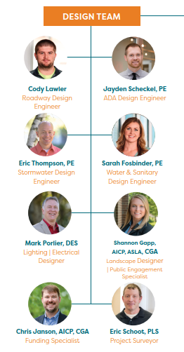
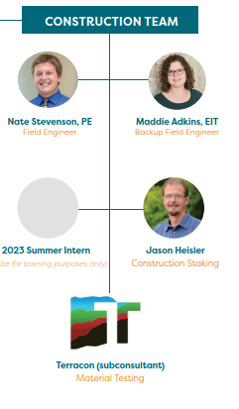
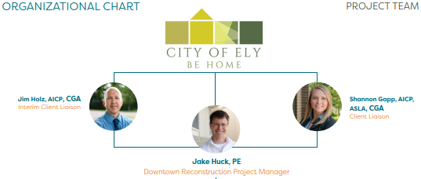
Ely Downtown Design Project Team

Slide 3
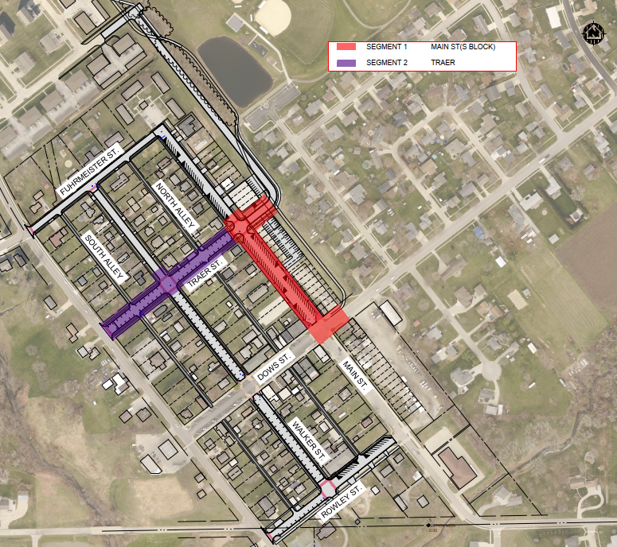
Phase 1 Segment Breakdown Main St. – South Block
Replace 650lf of Watermain
Install 780lf of Storm Sewer
Upgrade Roadway and Sidewalks
Add 58 Parking Spots
Add Bike Parking
Install Street Lighting with Event Power
Install Landscaping, Pavers, and Plantings
61’ Cross Section w/ Angled Parking, 3.5’ Paver Boulevard, and 6’ Sidewalk
Still working out details with the property owner for this stub

Slide 4
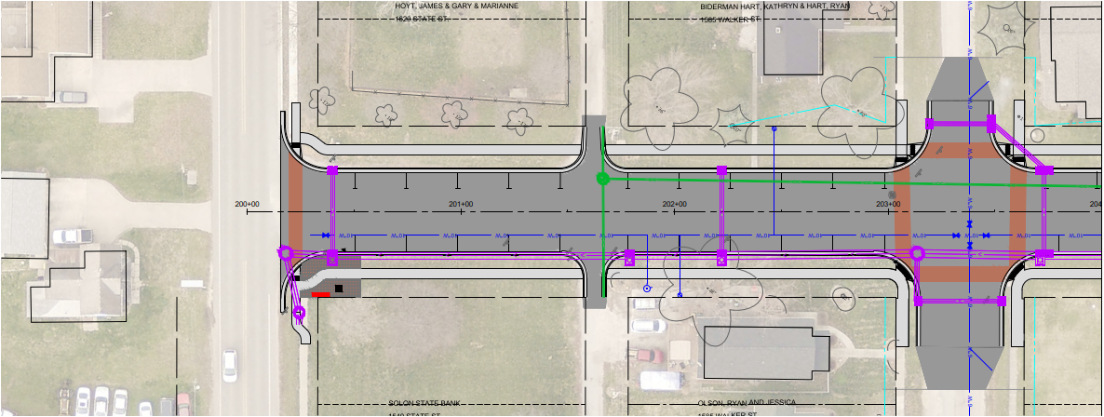
Phase 1 Segment Breakdown Traer St. – South Block
Replace 520lf of Watermain
Install 600lf of Storm Sewer
Upgrade Roadway and Sidewalks
Install Veteran’s Memorial
Add 20 Parking Spots
Replace 250lf of Sanitary Sewer
41’ Cross Section w/ Parallel Parking, 6’ Grass Boulevard, and 5’ Sidewalk

Slide 5
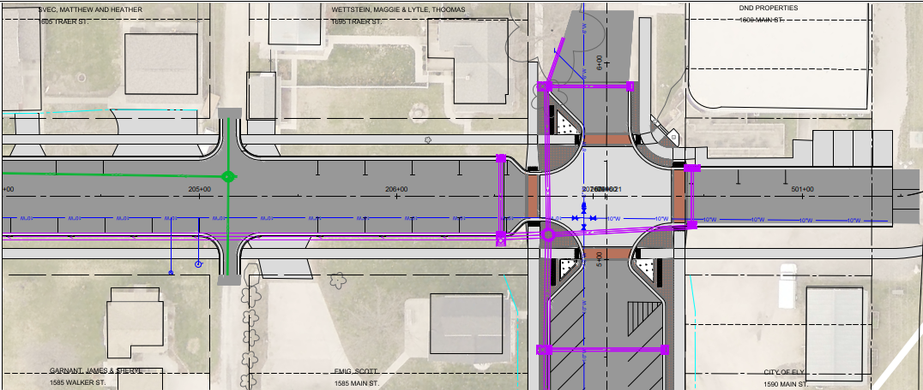
Phase 1 Segment Breakdown Traer St. – North Block
Replace 300lf of Watermain
Install 300lf of Storm Sewer
Upgrade Roadway and Sidewalks
Add 13 Parking Spots
Replace 150lf of Sanitary Sewer
41’ Cross Section w/ Parallel Parking, 6’ Grass Boulevard, and 5’ Sidewalk
Still working out details with the property owner for this stub

Slide 6
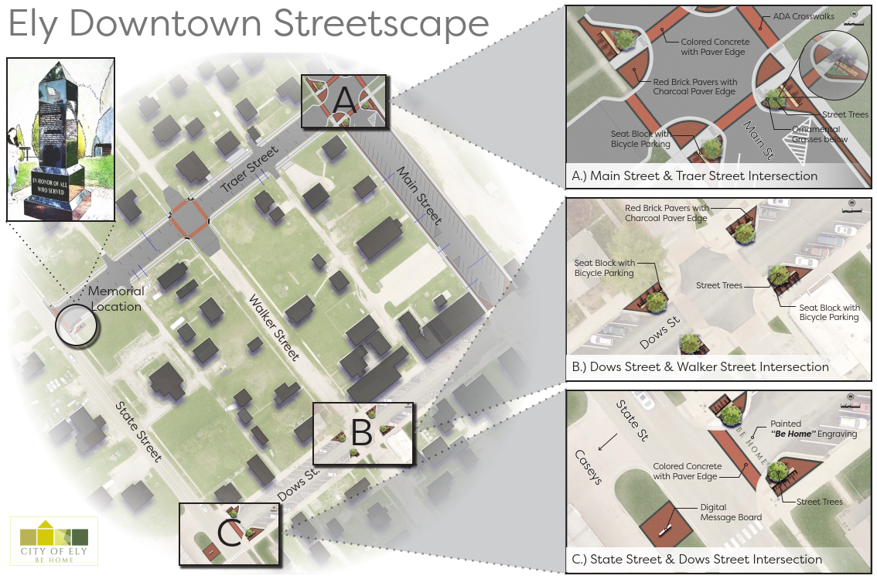
Phase 1 Segment Breakdown Streetscape

Slide 7
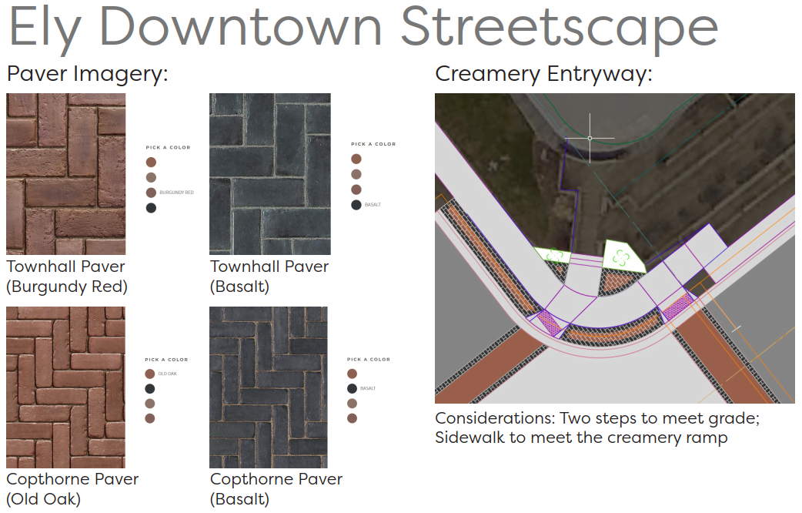
Phase 1 Segment Breakdown Streetscape

Slide 8
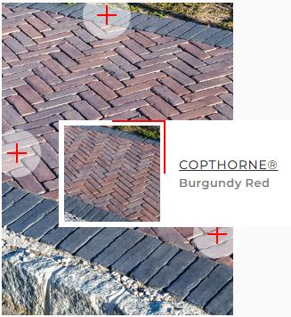
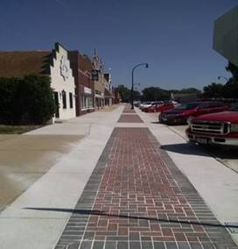
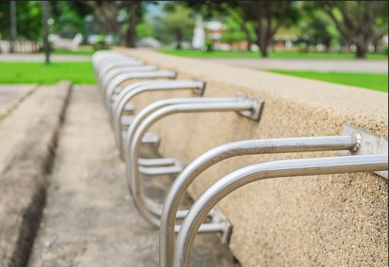
Phase 1 Segment Breakdown Streetsacpe Material Board
Possible Alternates/Material Board

Slide 9
Ely Downtown Design Phase 1 Overview
Phase Limits
Phase Schedule
Spring 2023: Bid Project
Summer 2023: Construct Phase 1
Fall 2023 – Spring 2024: Alley Sewer Repair
and Overlay

Slide 10
Phase 1 Cost Breakdown (Construction Only)
Phase 1 Breakdown (Construction Only)
Main St. (South Block): $1,500,000
Traer St.: $1,220,000
Phase 1 Total (Construction Only): $2,720,000

